Slide 1

Aging Infrastructure and Energy Efficiency: An Analysis of Buildings and their Energy Consumption in Chicago
Presented By: Team 6
Harishobith Reddy Anantha
Tejodbhav Koduru
Munukutla Durga Venkata Kashyap

Slide 2
Contents
Introduction
Motivation
Problem Statement
Related Works
Final Results
Future Work
Conclusion

Slide 3
Introduction
Problem Statement: Addressing energy inefficiency in aging urban infrastructures.
Relevance: Crucial for sustainable urban development and reducing environmental footprint.
Primary Objective: Analyze how building age influences energy consumption and efficiency in Chicago.
Impact: Inform policy decisions and practical interventions for energy conservation.
Notes:
Energy inefficiency in aging urban infrastructures is a significant challenge, particularly in cities like Chicago, where older buildings dominate the landscape. These inefficiencies lead to increased energy consumption, higher carbon emissions, and elevated operational costs, making them critical areas for intervention. Addressing this issue is crucial for sustainable urban development, as cities must find ways to reduce their environmental footprint while meeting growing energy demands. The primary objective of our project is to analyze how building age influences energy consumption and efficiency. Chicago, with its diverse infrastructure, offers an ideal setting for this analysis, enabling us to uncover patterns and opportunities for conservation. The impact of this work is substantial, as it provides actionable insights to inform policy decisions and practical interventions, such as retrofitting aging buildings, optimizing energy usage, and enhancing urban planning. By tackling inefficiencies in older infrastructures, we aim to contribute to a more sustainable and energy-efficient urban future.

Slide 4
Motivation
Aging buildings in cities like Chicago demand urgent solutions to reduce energy inefficiency and support sustainable development.
Improving energy efficiency reduces greenhouse gas emissions and lowers energy costs, benefiting both the environment and residents.
Energy-efficient buildings improve comfort, reduce utility expenses, and contribute to healthier living conditions for urban communities.
Research on energy efficiency in aging infrastructure inspires technological advancements and fosters a culture of sustainability.
Notes:
Aging buildings in cities like Chicago face significant energy inefficiency challenges, requiring immediate solutions to support sustainable development. Improving energy efficiency reduces greenhouse gas emissions, lowers energy costs, and benefits both the environment and residents. Energy-efficient buildings enhance comfort, cut utility expenses, and promote healthier living conditions. Additionally, research in this area drives technological innovation and fosters a culture of sustainability, making it a critical step toward creating more sustainable urban environments.

Slide 5
Existing Methods
Environmental Monitoring Systems [1]
Usage: Widely used by agencies for real-time environmental monitoring.
Limitations: Lack integration with broader urban planning data.
Energy Audits and Benchmarking [2]
Usage: Assess and benchmark energy consumption in buildings.
Limitations: Limited application at a broader urban scale.
Public Engagement Platforms [3]
Usage: Engage the public in environmental monitoring.
Limitations: Variable data quality and limited public participation.
[1] Apte, J. S., Messier, K. P., Gani, S., Brauer, M., Kirchstetter, T. W., Lunden, M. M., … & Marshall, J. D. (2017). High-Resolution Air Pollution Mapping with Google Street View Cars: Exploiting Big Data. Environmental Science & Technology, 51(12), 6999-7008.
[2] Pérez-Lombard, L., Ortiz, J., & Pout, C. (2008). A review on buildings energy consumption information. Energy and Buildings, 40(3), 394-398.
[3] Kim, S., & Lee, J. H. (2017). E-participation, transparency, and trust in local government. Public Administration Review, 77(6), 851-860.
Notes:
Environmental Monitoring Systems are widely used for real-time environmental data but often lack integration with broader urban planning efforts. and the second one, Energy Audits and Benchmarking help assess energy consumption in buildings but are limited in application at a city-wide scale. And the third one, Public Engagement Platforms encourage community involvement in monitoring energy consumption of buildings, but face challenges with data quality and participation. While these methods are valuable, their limitations highlight the need for more integrated and scalable approaches to address urban energy efficiency.

Slide 6
Data Description
Dataset: Energy Consumption Data
Source: Chicago Energy Benchmarking
Resolution: Detailed property-level data, allowing for precise analysis of energy metrics within specific locations.
Data Points: 24,891 entries.
Parameters:
Data Year: The collection year for the data.
Property Name and ID: Identifiers for specific properties.
ZIP Code and Community Area: Geographic identifiers.
Energy Ratings: Ratings including Chicago Energy ratings and exemptions.
Gross Floor Area: Property sizes in square feet.
Electricity Use: Detailed consumption figures in kBtu.
Gas Use: Detailed consumption figures in kBtu.
ENERGY STAR Score: Ratings reflecting energy efficiency.
GHG Emissions: Total greenhouse gas emissions in metric tons of CO2 equivalent.
Site and Source EUI: Energy Use Intensity per square foot at the site and from all energy sources.
Latitude and Longitude: Coordinates for spatial analysis.

Slide 7
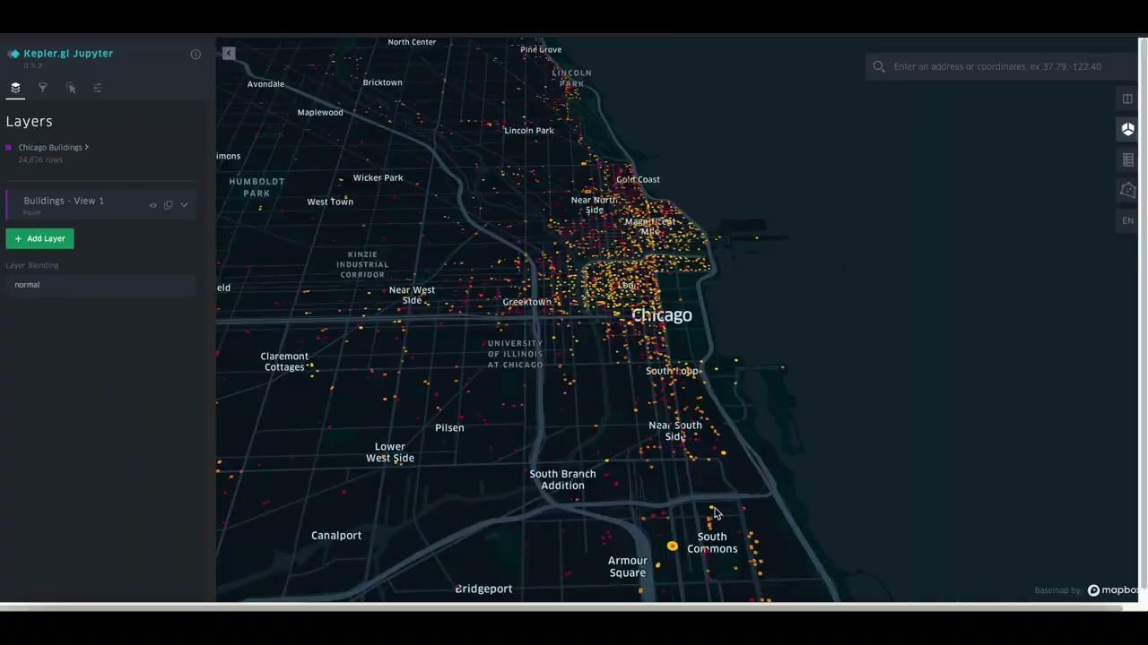
Final results
Visualization 1:
An interactive visualization using KeplerGL
Gives more filter options to the user and more freedom to select and drag over the map as they wish.
They can search by address or pincode, and select individual building to know the age, energy consumption and the GHG emissions.
The user can utilize the handy brushing tool or drag and draw on the map to check for locations in an immediate area.

Slide 8
Final results
Visualization 2 - Simulation Bar Chart: Predicting Building Energy Metrics
Input Parameters: Building Age, Floor Area, Energy Star Score
Technologies: Python, HTML, CSS, JS, Flask, Random Forest Regression
Process:
User inputs values.
Three Random Forest models predict Site EUI, GHG Intensity, Total GHG.
Results displayed in bar chart and numerical values.
Why It’s Useful: Provides tailored energy insights for decision-making.
Notes:
Visualization 2 - Simulation Bar Chart: Predicting Building Energy Metrics
Overview: This visualization allows users to predict energy metrics for a hypothetical building based on input parameters. By entering Building Age, Floor Area, and ENERGY STAR Score, users can instantly see a bar chart depicting three predicted metrics:
Site EUI (Energy Use Intensity)
GHG Intensity (Greenhouse Gas Intensity)
Total GHG Emissions
How We Did It:
User Input Collection: Building Age, Floor Area, ENERGY STAR Score via a web form.
Prediction Models: Backend Flask API processes inputs using three Random Forest regression models trained on historical energy data.
Visualization: Chart.js dynamically renders a bar chart and displays numerical results below.
Technologies Used:
Frontend: HTML, CSS, JavaScript, Chart.js
Backend: Flask API, Pandas
Machine Learning: Random Forest regression models for energy predictions.

Slide 9
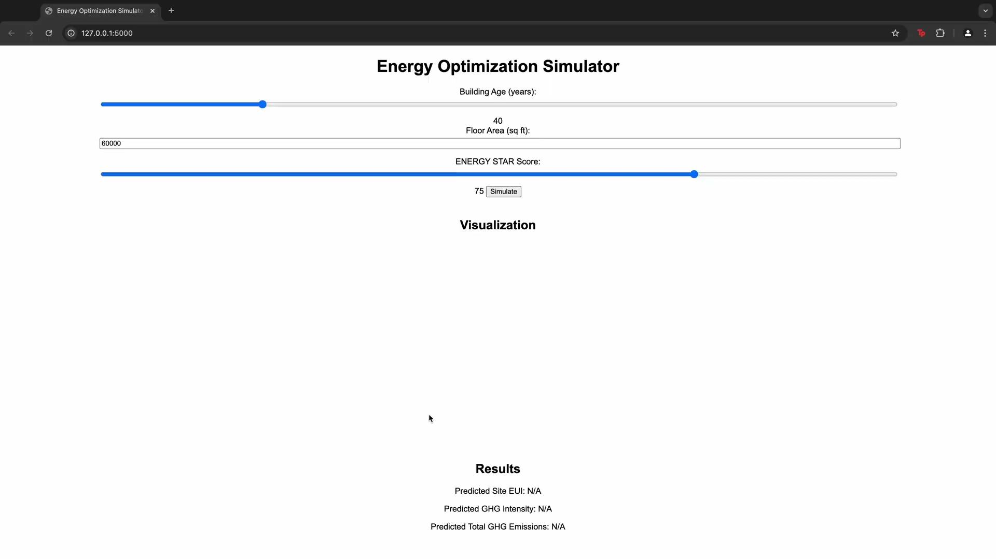
Final results
Visualization 2:
Notes:
Provides a quick, intuitive understanding of potential energy performance for a hypothetical building.
Enables decision-makers to identify high GHG or energy-intensive buildings proactively.

Slide 10
Final results
Visualization 3 - Chicago Map with Building Clusters
Input Parameters: Same as Visualization 1
Technologies: Python, HTML, CSS, JS, Flask, Leaflet.js
Process:
Circles on the map represent buildings.
Circle color indicates GHG emissions.
Circle radius reflects Site EUI.
Why It’s Useful: Visualizes city-wide energy performance hotspots.
Notes:
Overview: This visualization displays Chicago’s buildings as circles on a map, with each circle indicating energy metrics:
Circle Color: GHG emissions.
Circle Radius: Site EUI.
How We Did It:
User Input Collection: Building Age, Floor Area, ENERGY STAR Score via a web form.
Prediction Models: Random Forest Model
Visualization: Leaflet.js is used to render a Chicago map with circle markers, dynamically sized and colored based on predicted metrics.
Technologies Used:
Frontend: HTML, CSS, JavaScript, Leaflet.js
Backend: Flask API, Pandas
Machine Learning: Random Forest regression models for energy predictions.

Slide 11
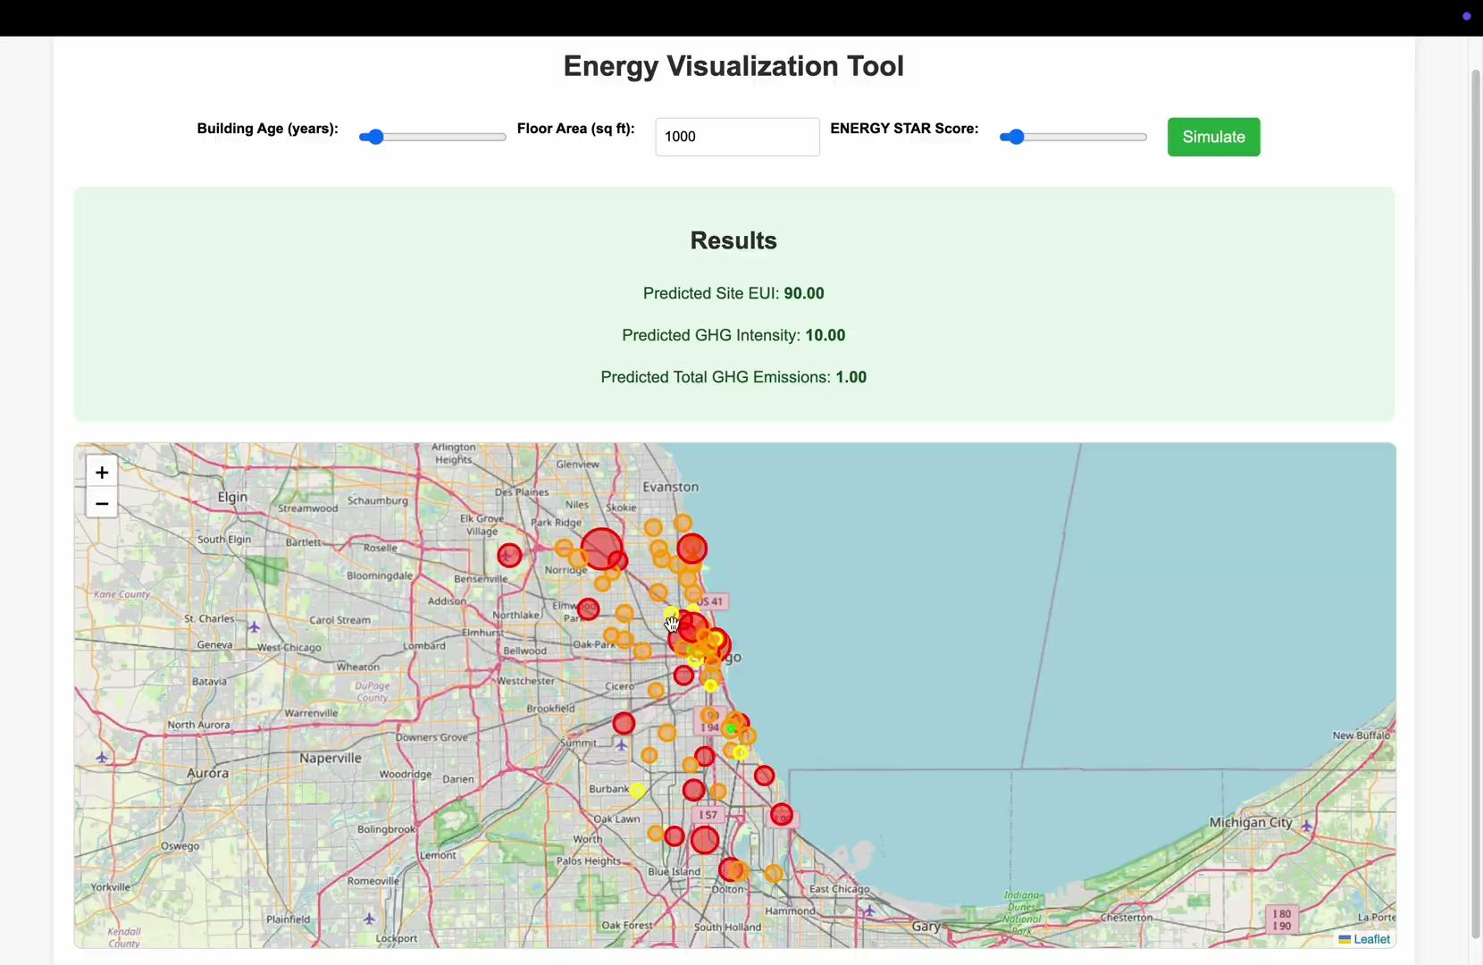
Final results
Visualization 3:
Notes:
Highlights energy-intensive clusters and outliers in a spatial context.
Enables planners to identify problem areas and prioritize interventions.

Slide 12
Retrofit Priority Score
Retrofit Priority Score
An index to prioritize buildings for retrofitting based on their potential for improvement in energy efficiency and emission reduction.
Formula: RPS = (Current EUI - Median EUI) + (GHG Emissions per Sq Ft - Benchmark GHG) Use:
Pinpoint Buildings with the most significant improvement opportunities.
Guide City Policies and Funding towards high impact projects.
Notes:
RPS Range Priority Interpretation
RPS ≥ 50 Critical These buildings are highly energy inefficient and emit significantly above-average greenhouse gases. Immediate retrofitting is needed.
25 ≤ RPS < 50 High These buildings have notable inefficiencies and should be prioritized for energy-saving interventions.
0 ≤ RPS < 25 Moderate Buildings in this range are performing close to average but still have room for improvement.
-25 ≤ RPS < 0 Low These buildings are slightly better than average but might benefit from minor efficiency upgrades.
RPS < -25 Efficient These buildings perform well in energy efficiency and emissions. They can serve as benchmarks or examples.

Slide 13
Final results
Visualization 4 - 3D Visualization: Retrofitting Priority and Energy Intensity
Technologies: Python, HTML, CSS, JS, Cesium.js, Flask
Process:
3D bars represent city Buildings.
Bar height: Site EUI.
Bar color: Retrofit Priority Score (RPS).
Why It’s Useful: Highlights retrofitting opportunities across the city.

Slide 14
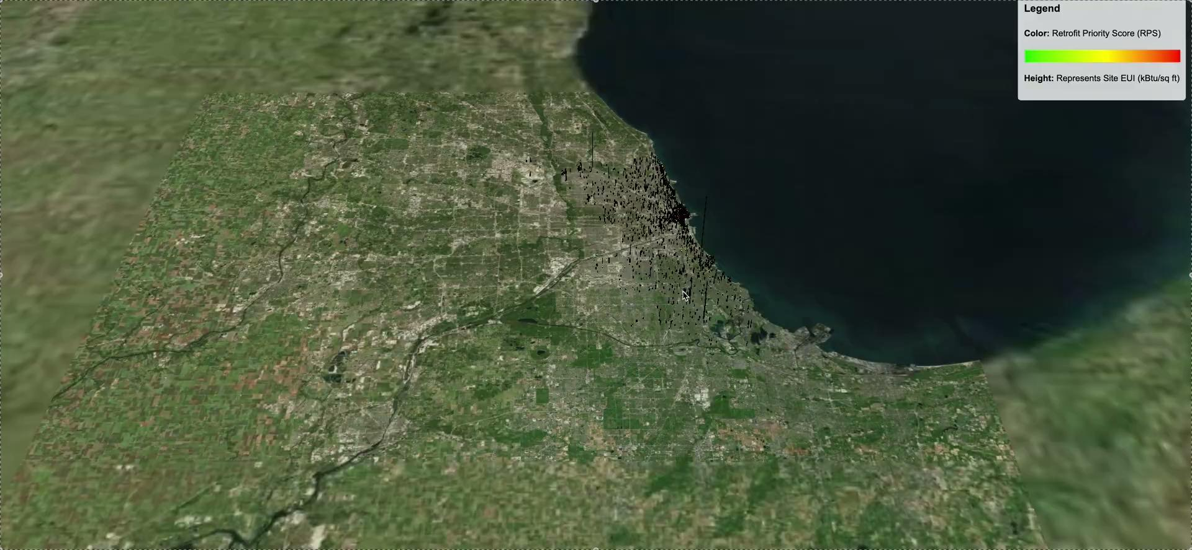
Final results
Visualization 4:
Notes:
Provides a visually impactful way to prioritize buildings for retrofitting.
Simplifies complex energy metrics into an understandable format for stakeholders.

Slide 15
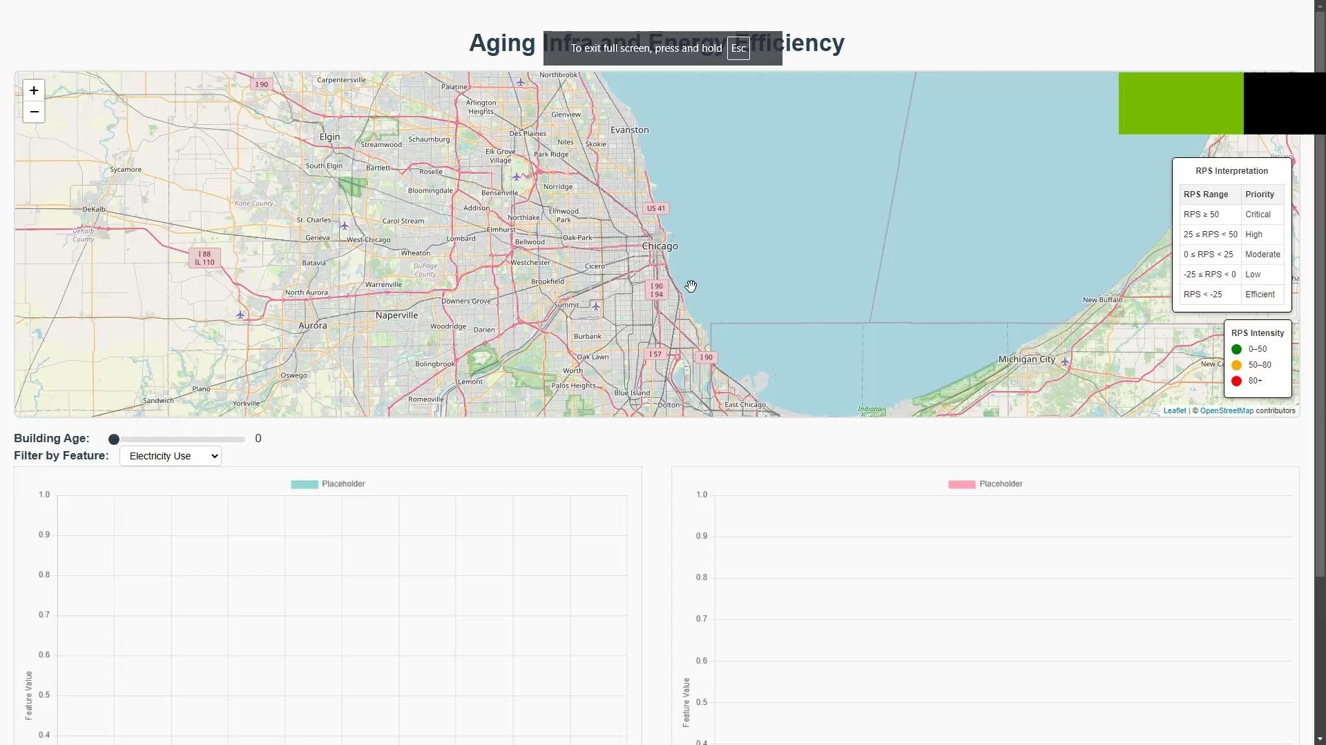
Interface

Slide 16
Future Work
Expanding Scope:
Extend predictions beyond single buildings to entire neighborhoods or the city, demonstrating retrofitting impacts at scale.
Develop area-wide energy consumption and GHG emission projections for urban planning.
Monetary Insights:
Integrate energy consumption predictions with billing data to showcase financial savings from retrofitting.
Provide actionable insights to incentivize retrofitting by linking cost savings to energy efficiency improvements.

Slide 17
Conclusion
Key Achievements:
Developed RPS - Retrofit Priority Score
Developed 4 impactful visualizations for energy and GHG analysis.
Integrated Random Forest models for accurate building predictions.
Our research highlights the relationship between building age, energy consumption, and GHG emissions
Presented a user-friendly, interactive web-based visualization tool.
Impact:
Promotes sustainable urban development by providing actionable insights for retrofitting and energy efficiency.
Bridges data visualization with sustainability goals.

Slide 18
Thank You

